Slide 1


Model United Nations
an introduction for students

Slide 2
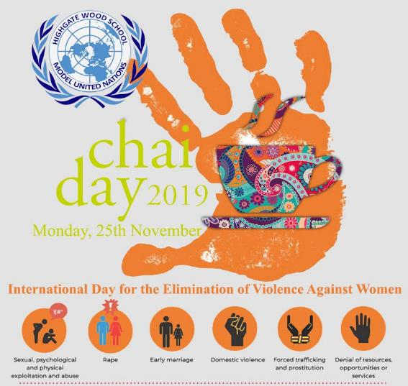
Model United Nations
an introduction for students

Slide 3
Model United Nations
an introduction for students
Part 1: The Basics
What is the UN?
    What is the General Assembly?
    What is the Security Council?
    What are Regional Groupings?
    What are Specialist Institutions?

Slide 4
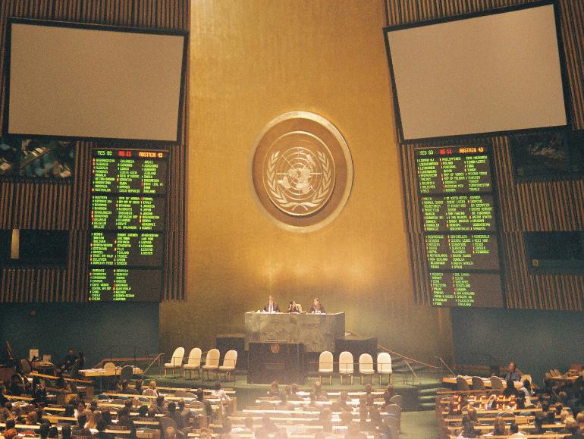
The General Assembly
The Parliament of the UN

Slide 5
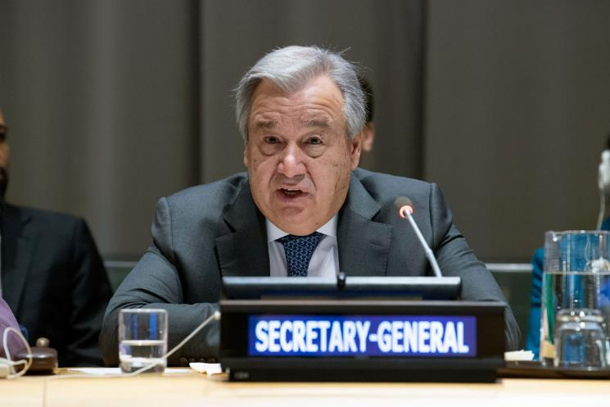
The Secretariat
The Civil Service of the UN
Antonio Guterres, Secretary General of the United Nations, replacing Ban Ki-moon, 2016

Slide 6
The Security Council
The ruling body of the UN where the 5 permanent members have a veto

Slide 7
Specialist Institutions of the UN
There are many UN organizations and agencies that function to work on particular issues.
Some of the most well-known agencies are:
  the International Atomic Energy Agency
  UNICEF (the UN Children's Fund)
  UNESCO (United Nations Educational, Scientific and Cultural Organization)
  the World Bank and
  the World Health Organization.
The United Nations Charter says that the UN can establish various specialized agencies to fulfil its duties.

Slide 8
Specialist Institutions of the UN
Key agencies of the UN that address the problem of Poverty:
  UNDP United Nations Development Programme
  UNICEF –The UN Body responsible for Children
  WHO World Health Organisation
  IFAD - International Fund for Agricultural Development
  World Bank and the WTO

Slide 9
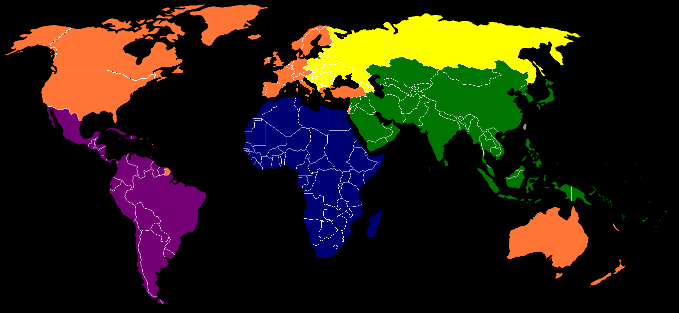
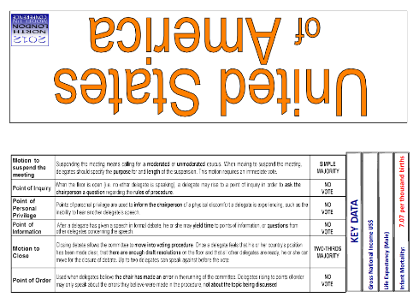
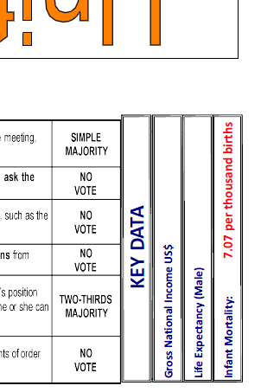

United Nations – Regional Groupings
There are 5 Permanent Members of the Security Council
  China
  France
  Russia
  United Kingdom
  USA

Slide 10
United Nations – Regional Groupings
Highest
Lowest
GNI
Life Expectancy (Male)
Infant Mortality

Slide 11
Model United Nations
an introduction for students

Slide 12
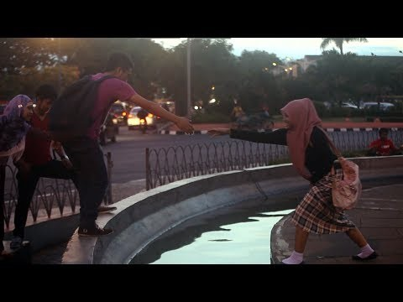
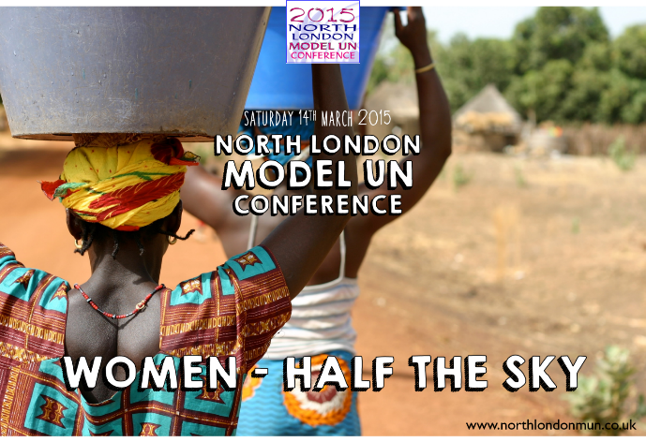
Model United Nations
an introduction for students

Slide 13
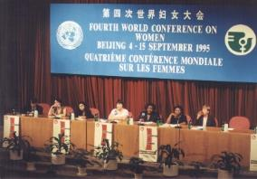
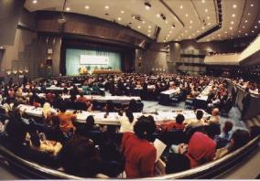
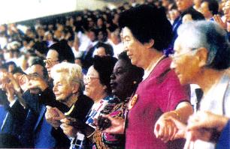
Model United Nations
an introduction for students
In September 1995, over 17,000 participants and 30,000 activists from 189 different nations arrived in Beijing for the Fourth World Conference on Women. Despite their diversity in culture and creed, in power and politics, these representatives were all united by a common cause: to eliminate the gender-based inequalities which restrict girls' futures and limit their ambitions, which imperil women’s safety and silence their voices.

Slide 14
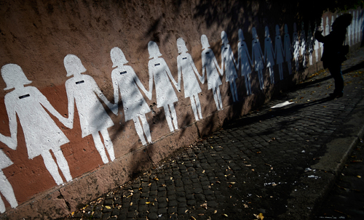
Model United Nations
an introduction for students
After two weeks of debate, the conference produced a document, the Beijing Declaration, which is still considered the most wide-ranging blueprint for the advancement of women’s rights. It addressed some of the most pressing issues of the time: education, violence, political representation, access to employment and equal pay, maternal health and the impact of the media.

Slide 15
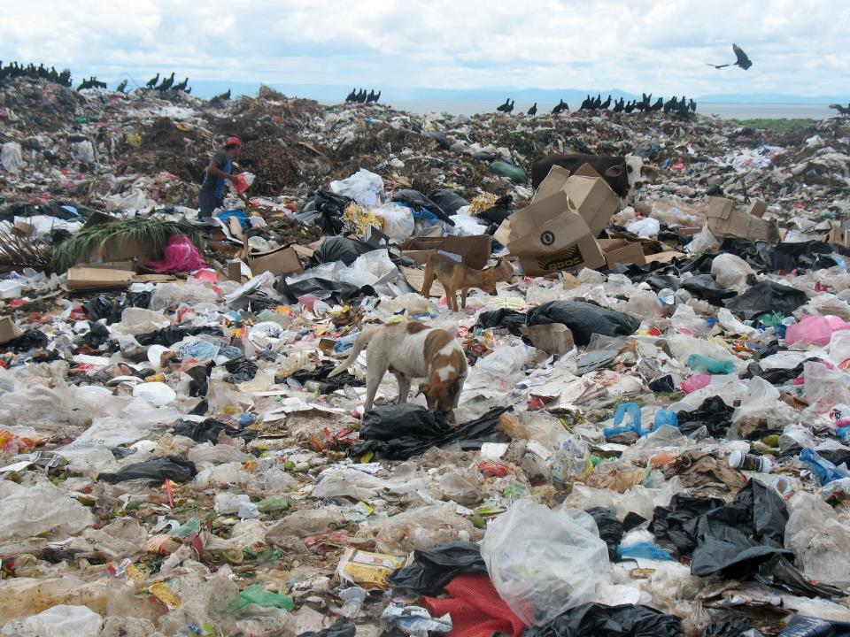
Since 1990, extreme poverty has been cut in half

Slide 16
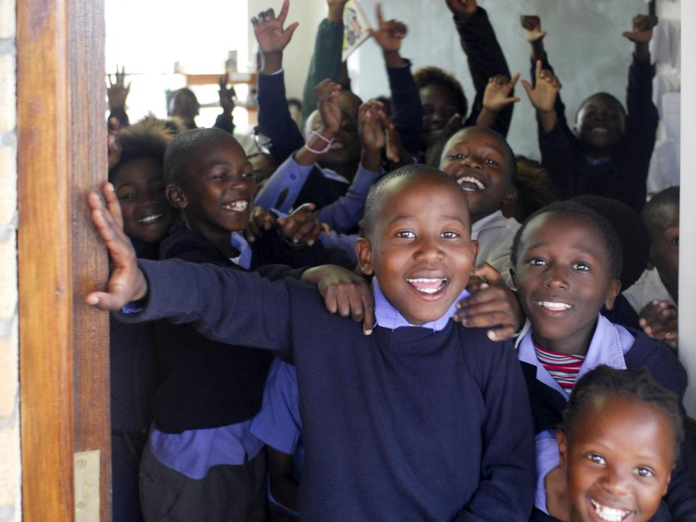
Enrolment in primary schools is up from 82% to 90%. Both girls and boys have an equal chance of starting primary school

Slide 17
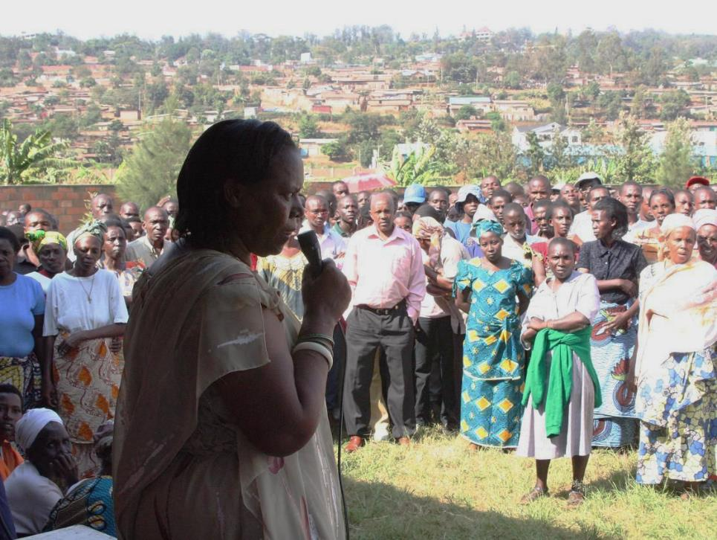
Women’s participation in politics is increasing. In January 2015, 46 countries had Parliaments where 30% of MPs were women

Slide 18
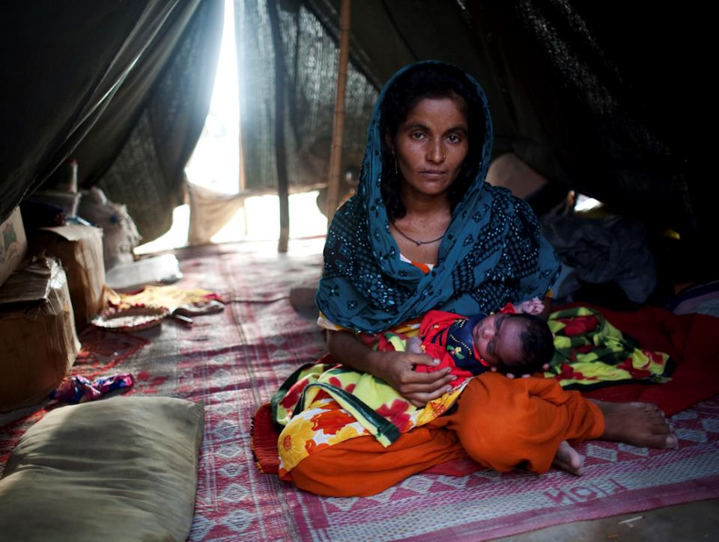
Maternal mortality has fallen by 45% since 1990, meaning fewer women die due to complications during childbirth

Slide 19

In some countries, a girl is lucky to be born at all
In China and India there are 120 boys born for every 100 girls.
The preference for male children is so strong that some parents will try to arrange an abortion if the doctor tells them their child is going to be a girl.
Experts call this gendercide; the widespread killing of members of a specific sex.
In 2012, it was estimated that the number of girls disposed of in this way was over 200 million.

Slide 20

In some countries, a girl is lucky to be born at all

Slide 21
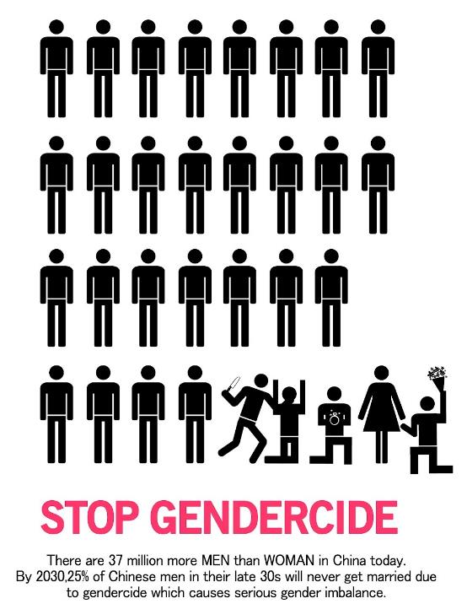
The long-term consequences for these countries are severe.
There are 37 million more men than women in China. How are they going to find a wife?

Slide 22
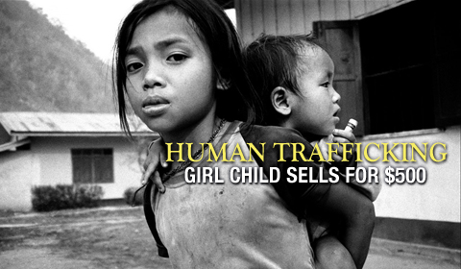
CHINA’S ONE-CHILD POLICY FUELS DEMAND FOR TRAFFICKED BRIDES
Vulnerable women in countries like Vietnam, North Korea, Laos, Cambodia and Burma – are being forced into marriages in China, experts say.
China suffers from one of the worst gender imbalances in the world as their families prefer male children. As a result, millions of men cannot find Chinese brides.

Slide 23
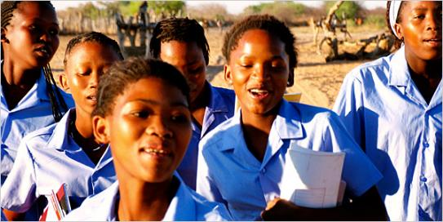
Once a girl is born, she will be lucky to receive an education
64% of illiterate adults are women, meaning around 493 million women cannot read or write. In some countries, such as Mali, only 29% of women are literate.
31 million girls of primary school age are not enrolled in school at all.
In secondary education, there are 84 girls in school for every 100 boys.

Slide 24
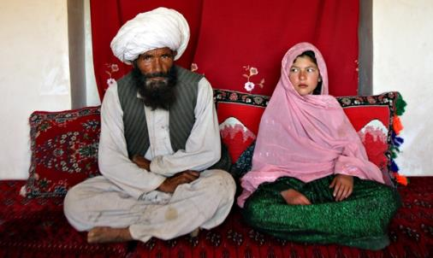
Once she becomes a teenager, she will be lucky to avoid being married…
Every day, 39,000 girls are forced into early marriage. That’s 27 girls a minute.
Around 14 million girls, some as young as eight years old, were married in 2014.
Once married, they are expected to drop out of school and start raising children.

Slide 25

Once she becomes a teenager, she will be lucky to avoid being married…

Slide 26
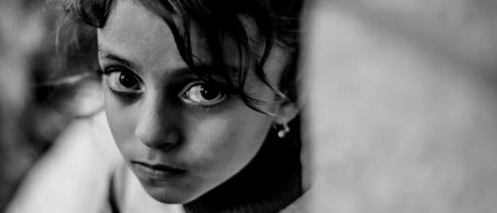
Once she becomes a teenager, she will be lucky to avoid the threat of violence…
Every 10 minutes an adolescent girl dies as a result of violence. Violence is the second leading cause of death amongst teenage girls.
1 in 10 adolescent girls have experienced serious sexual violence. In some individual countries, the figure is much higher than this. For example, in DRC, 70% of girls have been sexually assaulted.

Slide 27

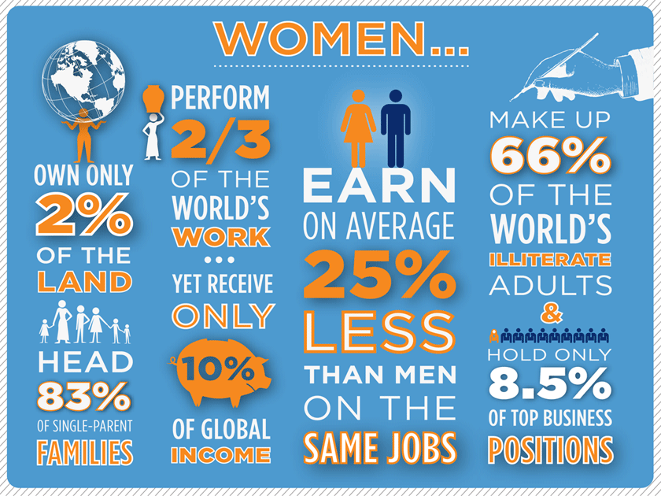

Slide 28

The reason for these injustices is sexism
Sexism produces attitudes which assume that women are just housewives & mothers
It produces men who believe the female body is theirs to do with as they please
It produces children who (if they are lucky enough to be born at all) will grow up knowing their ambitions will be limited, their safety threatened, their voice ignored, simply because they are girls.

Slide 29
If all girls went to school…
Educated women are less likely to die in childbirth:
If all mothers completed primary education, maternal deaths would be reduced by two-thirds, saving 98,000 lives
Educating girls can save millions of lives:
If all women had a primary education, there would be 15% fewer child deaths. If they had a secondary education, child deaths would be cut in half, saving 3 million lives.
Girls with higher levels of education are less likely to have children at an early age
Almost 60% fewer girls would become pregnant under 17 years in sub-Saharan Africa and South and West Asia if they all had a secondary education.
Girls with higher levels of education are less likely to get married at an early age
If all girls had a primary education, there would be 14% fewer child marriages If all girls had a secondary education, there would be two-thirds fewer child marriages

Slide 30
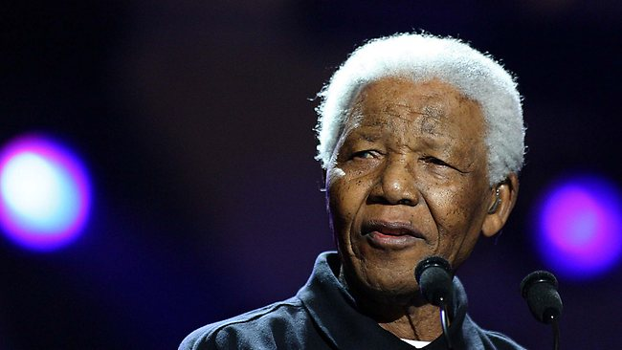
“For every woman and girl violently attacked, we reduce our humanity. For every woman forced into unprotected sex because men demand this, we destroy dignity and pride. Every woman who has to sell her life for sex we condemn to a lifetime in prison. For every moment we remain silent, we conspire against our women. For every woman infected by HIV, we destroy a generation.”
President Nelson Mandela (1918 – 2013)

Slide 31
The Four Essentials of MUN:
Participants are assigned a UN Member State and they play the role of a diplomat for their country.
They present their country’s views and national interests, rather than their own personal opinions on an issue.
Delegates research their country, learning about its relations with other states and especially about their country’s perspective on the topic to be discussed at the MUN.
Discussions can cover any issue of global importance; in this case
‘Women & Girls’
1
2

Slide 32
The Four Essentials of MUN:
The delegates simulate the UN meetings, using agreed rules of procedure
The delegates present their countries’ positions and debate and negotiate with the other delegations, in both formal and informal sessions.
A resolution is drafted, discussed, amended and voted upon, in response to the debate and issues raised by states.
An approved resolution represents the final product of the meeting, voted on by all countries at the General Assembly.
3
4

Slide 33
Before the Conference
Students need to:
  research the issue (in this case, particular to your committee) and its global context
  research the country they have been allocated (eg economy, government, history and alliances)
  write a ‘position paper’ that addresses the issue from your country’s perspective
  know how to work the procedures of the UN to get your goal

Slide 34


